Slide 1
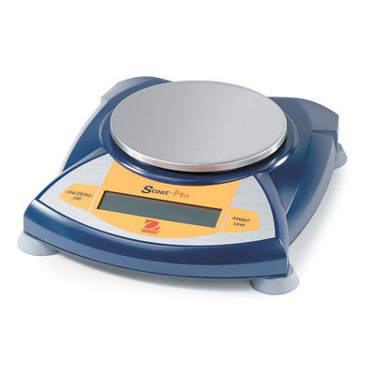
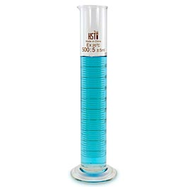
Measurements in Chemistry
Mass
Volume

Slide 2
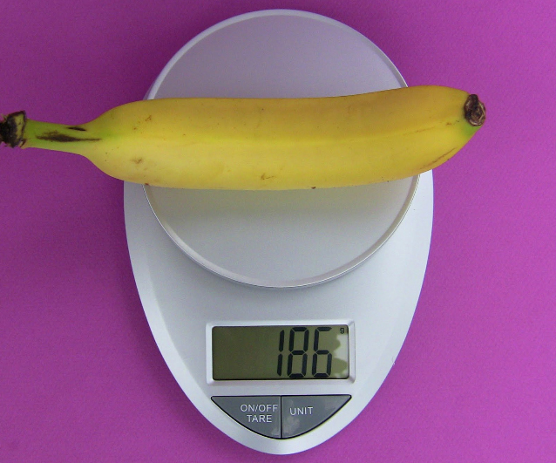
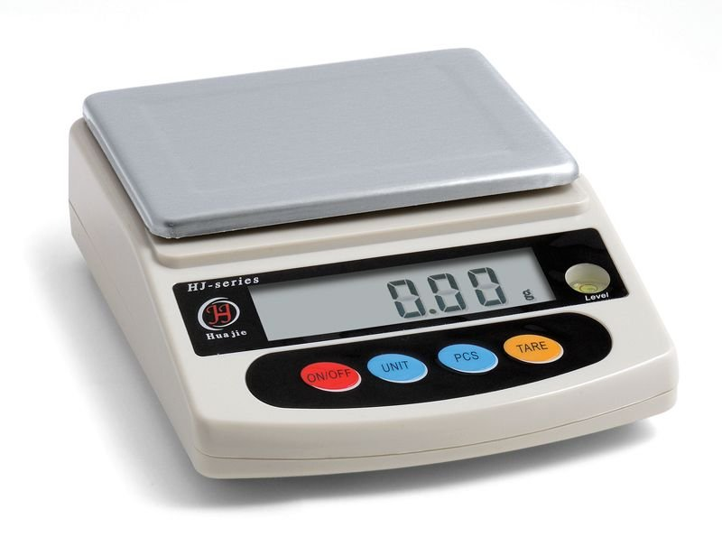
Consider the two balances below:
Balance 1:
the banana has a mass of 186 grams
Balance 2:
the same banana might have a mass of 185.92 g or 186.25 g etc. We CAN’T assume that the mass would be 186.00 g

Slide 3
RULE #1:
When adding or subtracting measured values, the answer has the same number of decimal places as the least number of decimal places in the question.
More examples:
10.1 g + 0.32 g =
5.56 g + 1.329 g =

Slide 4
Example: 2 objects are massed, one using balance 1 and the other using balance 2
Mass of object 1: 25 g
Mass of object 2: 13.45 g
The total of both masses is 38 g NOT 38.45 g
Why?
We don’t know what the decimal places would have been if object 1 had been massed on balance 2 – we can’t assume it was 25.00 g!

Slide 5
More examples:
10.1 g + 0.32 g =
5.56 g + 1.329 g =

Slide 6
Significant Digits
The number of digits that we are certain of (significant digits) depends on the graduations of the measuring device
For example:
Using balance 1, the mass of the banana has been measured to _____ significant digits
Using balance 2, the mass of the banana has been measured to _____significant digits
All calculations we perform with measured values must reflect the number of significant digits (for multiplying and dividing) OR the number of decimal places (for adding and subtracting) that the measured value has

Slide 7
How to determine the number of significant digits a measured value has:
All non-zero digits are significant
186 has __ significant digits; 185.89 has __ significant digits
The ONLY zero digits that are NOT significant are the ones leading up to a decimal point
0.632 has __ significant digits; 0.00632 has __ significant digits; 0.63200 has __ significant digits 0.06302 has ___ significant digits

Slide 8
How many significant digits?
123.4
0.023
0.00030
8120.0
804
800

Slide 9
Round each number to the number of significant digits indicated:
0.3261 (to 3)
679.5 (to 3)
561 (to 2)
0.00344 (to 2)
540 (to 1)

Slide 10
RULE #2:
When multiplying and dividing measured values, the answer has the same number of significant digits as the least number of significant digits in the question.

Slide 11
Using RULE #2:
Answer the following to the correct number of significant digits:
563 x 21 =
45/ 56.15 =
0.00123 x 0.115 =
0.702 x 1.20 =

